Slide 1

Humanities Research with Sound: Introduction to Audio Machine Learning
Stephen McLaughlin
& Tanya Clement

Slide 2
Stephen McLaughlin / @SteveMcLaugh
Notes:
http://gtspirit.com/2014/03/12/renault-caterham-sports-car-design-as-good-as-finished/

Slide 3
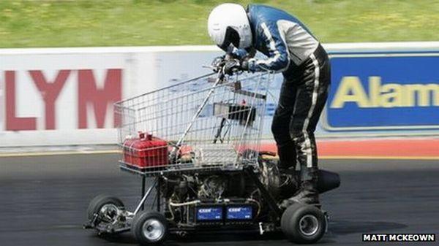
Stephen McLaughlin / @SteveMcLaugh
Notes:
https://www.youtube.com/watch?v=xz8_udPVdok
Fast, but not the easiest thing to handle — and it might be a bumpy ride

Slide 4
https://github.com/hipstas/shaping-humanities-data
Stephen McLaughlin / @SteveMcLaugh

Slide 5
The motivation: Decaying media must be digitized quickly. Rich metadata is often an afterthought.
Stephen McLaughlin / @SteveMcLaugh
Notes:
“The Library of Congress National Recording Preservation Plan” 2012
We are the afterthought; we’re doing the afterthinking.

Slide 6
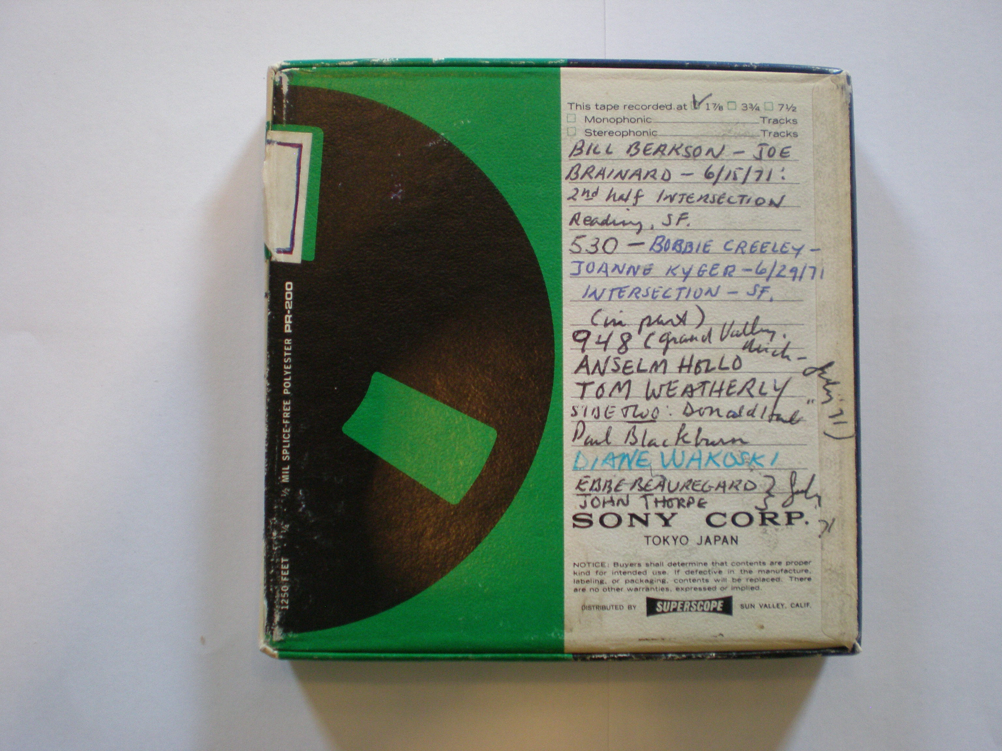
Stephen McLaughlin / @SteveMcLaugh
Notes:
If you’re lucky, someone will transcribe the box.

Slide 7
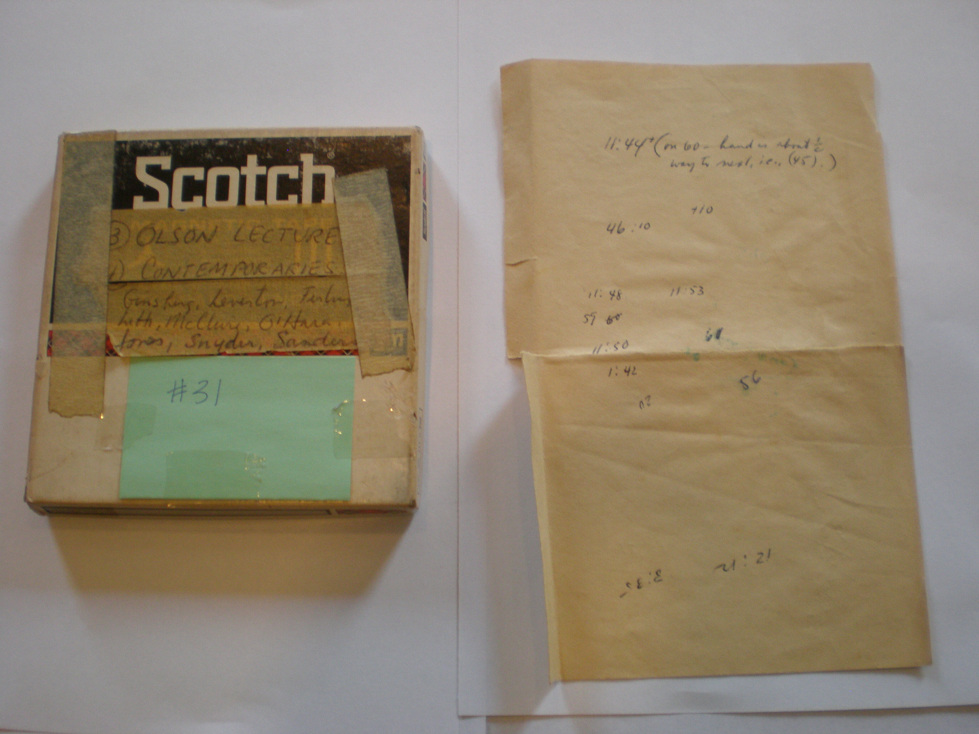
Stephen McLaughlin / @SteveMcLaugh
Notes:
I commend PennSound for making these images available to methodical scrapers.

Slide 8
Stephen McLaughlin / @SteveMcLaugh
Notes:
I commend PennSound for making these images available to methodical scrapers.

Slide 9
Possible uses of ML in digital audio collections
Packaging old material for online distribution
Stephen McLaughlin / @SteveMcLaugh

Slide 10
Possible uses of ML in digital audio collections
Packaging old material for online distribution
Making collections searchable for scholars
Stephen McLaughlin / @SteveMcLaugh

Slide 11
Possible uses of ML in digital audio collections
Packaging old material for online distribution
Making collections searchable for scholars
Helping curators find interesting things
Stephen McLaughlin / @SteveMcLaugh

Slide 12
Possible uses of ML in digital audio collections
Packaging old material for online distribution
Making collections searchable for scholars
Helping curators find interesting things
???
Stephen McLaughlin / @SteveMcLaugh

Slide 13
What do you need to classify sound?
A little theory
Stephen McLaughlin / @SteveMcLaugh

Slide 14
What do you need to classify sound?
A little theory
Intuition w/r/t what is tractable
Stephen McLaughlin / @SteveMcLaugh

Slide 15
What do you need to classify sound?
A little theory
Intuition w/r/t what is tractable
Patience and skills to manage lots of audio files
Stephen McLaughlin / @SteveMcLaugh

Slide 16
What do you need to classify sound?
A little theory
Intuition w/r/t what is tractable
Patience and skills to manage lots of audio files
Features
Stephen McLaughlin / @SteveMcLaugh

Slide 17
What do you need to classify sound?
A little theory
Intuition w/r/t what is tractable
Patience and skills to manage lots of audio files
Features
A passable algorithm
Stephen McLaughlin / @SteveMcLaugh

Slide 18
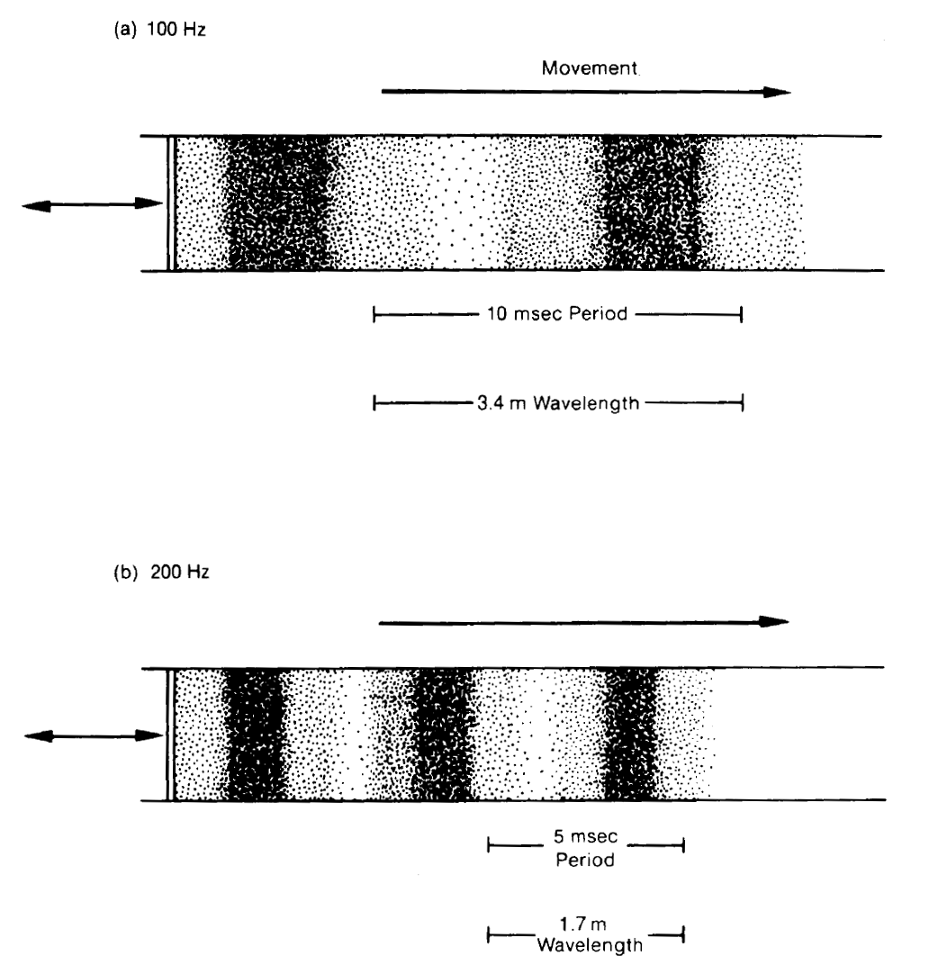
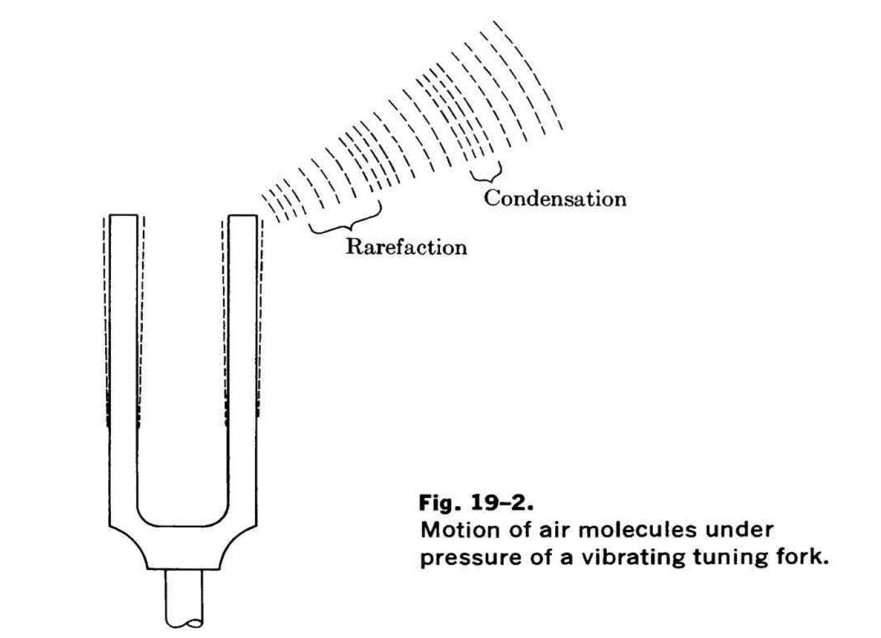
Stephen McLaughlin / @SteveMcLaugh
Notes:
This is not an option.

Slide 19
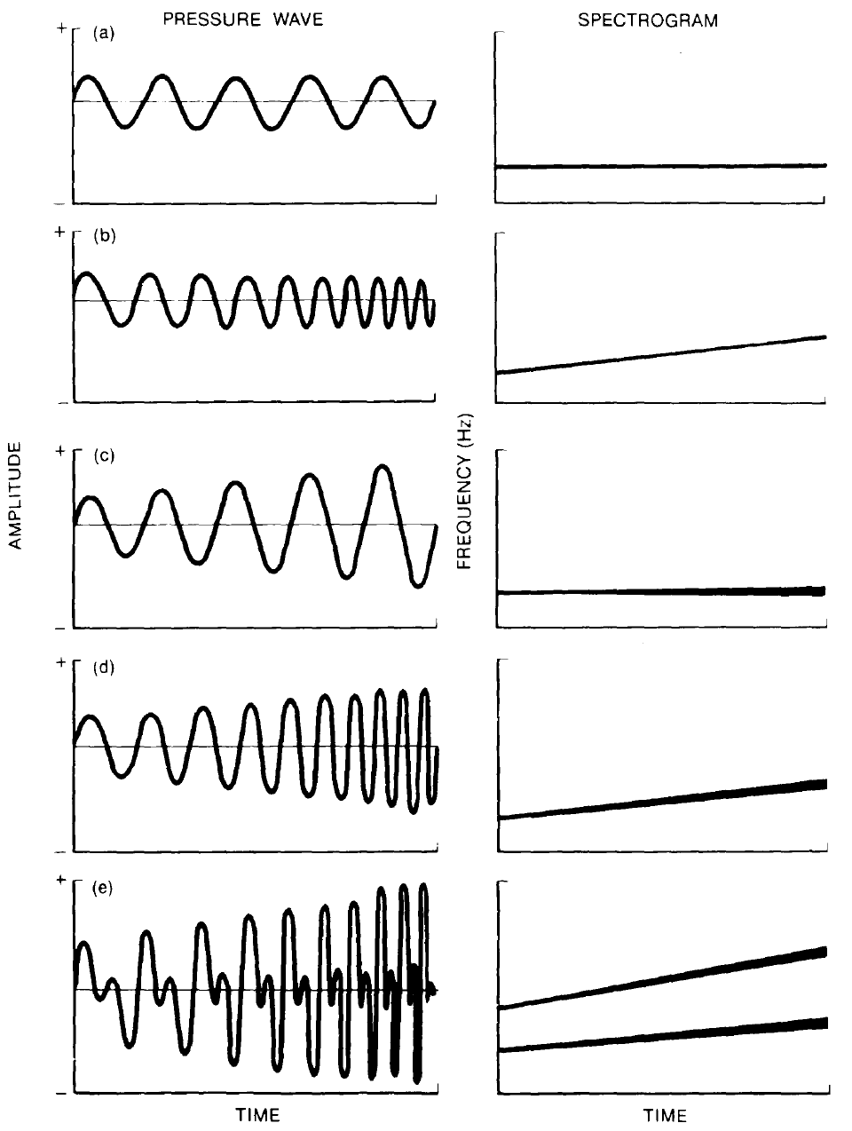
Credit: Handel 1989
Stephen McLaughlin / @SteveMcLaugh
Notes:
This is not an option.

Slide 20
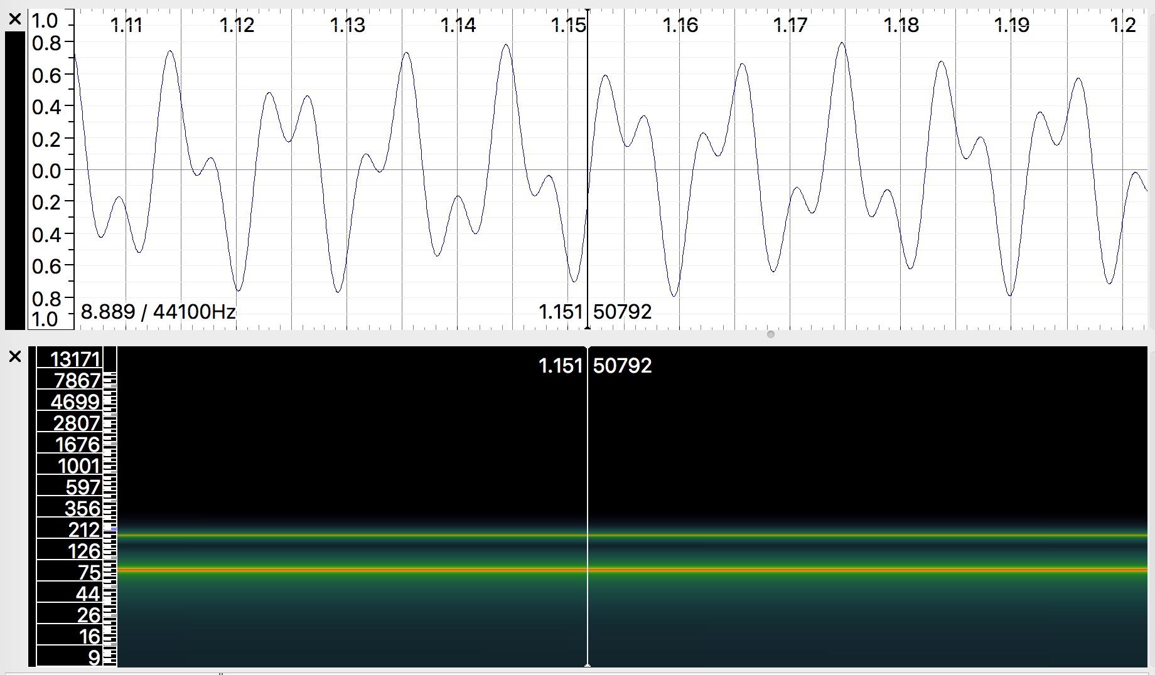
Stephen McLaughlin / @SteveMcLaugh
Notes:
This is not an option.

Slide 21
Some tasks are easy.
Stephen McLaughlin / @SteveMcLaugh

Slide 22
Some tasks are easy.
Music/speech classification
Stephen McLaughlin / @SteveMcLaugh

Slide 23
Some tasks are easy.
Music/speech classification
Applause detection
Stephen McLaughlin / @SteveMcLaugh

Slide 24
Some tasks are easy.
Music/speech classification
Applause detection
Identifying test tones and silence
Stephen McLaughlin / @SteveMcLaugh

Slide 25
Some tasks are hard.
Stephen McLaughlin / @SteveMcLaugh

Slide 26
Some tasks are hard.
Speech to text
Stephen McLaughlin / @SteveMcLaugh

Slide 27
Some tasks are hard.
Speech to text
Measuring affect
Stephen McLaughlin / @SteveMcLaugh

Slide 28
Some tasks are hard.
Speech to text
Measuring affect
Speaker identification
Stephen McLaughlin / @SteveMcLaugh

Slide 29
Humanities research ≠ ML research
Stephen McLaughlin / @SteveMcLaugh

Slide 30
Humanities research ≠ ML research
Our collections are noisy.
Stephen McLaughlin / @SteveMcLaugh

Slide 31
Humanities research ≠ ML research
Our collections are noisy.
Preprocessing is key; CPU cycles are limited.
Stephen McLaughlin / @SteveMcLaugh

Slide 32
Humanities research ≠ ML research
Our collections are noisy.
Preprocessing is key; CPU cycles are limited.
I’m a bad programmer.
Stephen McLaughlin / @SteveMcLaugh

Slide 33
Humanities research ≠ ML research
Our collections are noisy.
Preprocessing is key; CPU cycles are limited.
I’m a bad programmer.
Sub-state-of-the-art systems may be OK.
Stephen McLaughlin / @SteveMcLaugh

Slide 34
Bottlenecks to wide application
Stephen McLaughlin / @SteveMcLaugh

Slide 35
Bottlenecks to wide application
Compute time
Stephen McLaughlin / @SteveMcLaugh

Slide 36
Bottlenecks to wide application
Compute time
Existing metadata quality
Stephen McLaughlin / @SteveMcLaugh

Slide 37
Bottlenecks to wide application
Compute time
Existing metadata quality
Human ML training time
Stephen McLaughlin / @SteveMcLaugh

Slide 38
Bottlenecks to wide application
Compute time
Existing metadata quality
Human ML training time
Technical literacy
Stephen McLaughlin / @SteveMcLaugh

Slide 39
Bottlenecks to wide application
Compute time
Existing metadata quality
Human ML training time
Technical literacy
Copyright restrictions
Stephen McLaughlin / @SteveMcLaugh

Slide 40
Changes in the past 5 years
Processors are faster.
Storage is cheaper.
VPSes are friendlier.
More and better core ML tools.
More and better high-level wrappers.
GitHub and Stack Exchange are much larger.
Stephen McLaughlin / @SteveMcLaugh
Notes:
And I’m gonna be ... permit me to deal in straw men for a sec. This isn’t even polemical, it’s just a matter of fact.

Slide 41
Our options
Stephen McLaughlin / @SteveMcLaugh

Slide 42
Our options
Unwieldy research software
bob.bio.spear, SIDEKIT, ALIZE
Stephen McLaughlin / @SteveMcLaugh

Slide 43
Our options
Unwieldy research software
bob.bio.spear, SIDEKIT, ALIZE
2 buckets & done: pyAudioAnalysis https://github.com/tyiannak/pyAudioAnalysis
Stephen McLaughlin / @SteveMcLaugh

Slide 44
pyAudioAnalysis
Created and maintained by Theodoros Giannakopoulos
Built on scikit-learn and the SciPy stack
Executes training, classification, silence removal, etc.
Handles dimension reduction and hyperparameter tuning
Simple interface, comprehensible code from pyAudioAnalysis import audioTrainTest as aT aT.featureAndTrain(['Background','Creeley'], 1.0, 1.0, aT.shortTermWindow, aT.shortTermStep, "svm", "svm_creeley", False)
Stephen McLaughlin / @SteveMcLaugh
Notes:
*
If I was bitter or disillusioned about poetry culture, it was perhaps because I hadn’t found my own community.
But eventually I did.
In the years following Issue 1 I got involved in practice.
I submitted videos to Ubuweb.
I did archival work for PennSound and edited the podcast PoemTalk at the Writers House.
I hosted my own poetry interview podcast on Jacket2.org
And I hosted a reading series in Philadelphia from 2011 to 2014, called Principal Hand Presents.
The scene I was a part of — conceptual, post-conceptual — was essentially a complete gift economy.
Giving chapbooks away, sharing PDFs, swapping ideas and links on email threads.
- That became central to my understanding of what it was to write, to make things. Not an alternative to mass culture, but a parallel track where we had some autonomy.

Slide 45
Our options
Unwieldy research software
bob.bio.spear, SIDEKIT, ALIZE
2 buckets & done: pyAudioAnalysis https://github.com/tyiannak/pyAudioAnalysis
General ML tools
scikit-learn, TensorFlow + Keras
Stephen McLaughlin / @SteveMcLaugh

Slide 46
 | Feature 1 | Feature 2 | Feature 3 | Feature 4
Label A | 11.3166 | 13.1009 | 17.1638 | 1.2876
Label A | 0.0023 | 8.9224 | 7.3368 | 12.826
Label A | 13.9563 | 11.0516 | 8.5414 | 14.0572
Label A | 1.7851 | 9.1011 | 10.7928 | 4.5441
Label B | 12.0978 | 10.4598 | 5.7786 | 12.4596
Label B | 0.28 | 17.3005 | 3.7776 | 11.1616
Label B | 7.3366 | 13.3285 | 13.3285 | 17.5108
Label B | 7.1498 | 13.6181 | 13.391 | 7.3366
Label B | 10.9546 | 6.7191 | 13.0848 | 3.9394
Stephen McLaughlin / @SteveMcLaugh
Notes:
This is not an option.

Slide 47
Types of machine learning
Supervised learning
starting with labeled training data
Unsupervised learning
inferring relationships without class labels
Reinforcement learning
neural networks
Stephen McLaughlin / @SteveMcLaugh
Notes:
#metadatagoals

Slide 48

Stephen McLaughlin / @SteveMcLaugh
Notes:
This is not an option.

Slide 49
Model
Training set
Algorithm
Validation set
Test set
Real world
Stephen McLaughlin / @SteveMcLaugh
Notes:
#metadatagoals

Slide 50
New tools from HiPSTAS
Stephen McLaughlin / @SteveMcLaugh

Slide 51
New tools from HiPSTAS
Audio Labeler (web app with GUI)
github.com/hipstas/audio-labeler
Stephen McLaughlin / @SteveMcLaugh

Slide 52
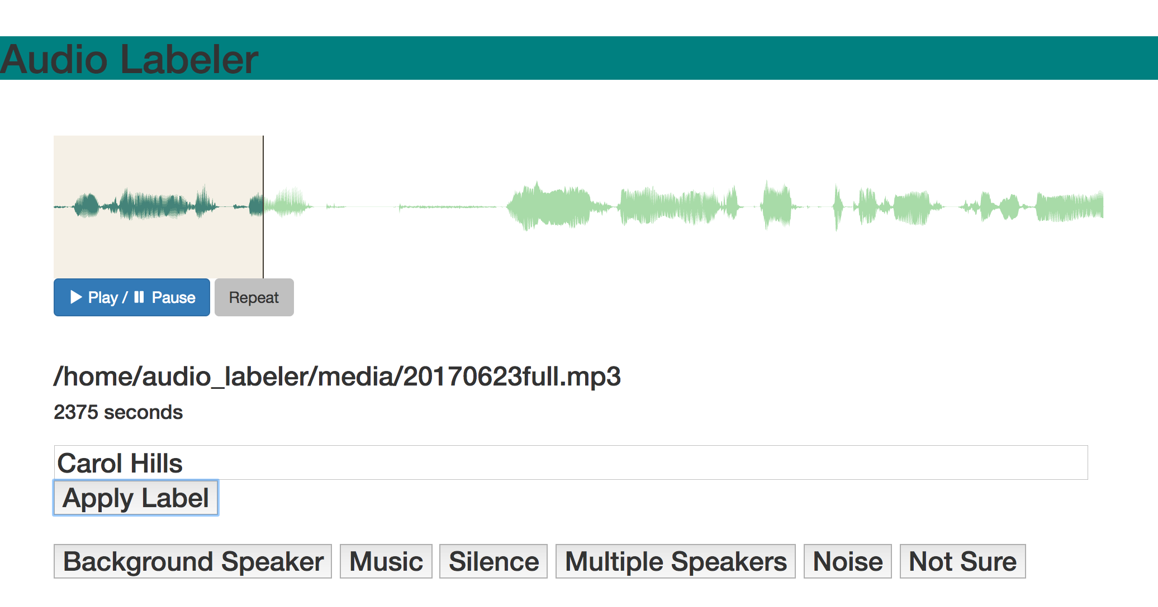

Slide 53
New tools from HiPSTAS
Audio Labeler (web app with GUI)
github.com/hipstas/audio-labeler
Audio Tagging Toolkit (Python package)
github.com/hipstas/audio-tagging-toolkit
Stephen McLaughlin / @SteveMcLaugh

Slide 54



PocketSphinx
Pyperclip
Stephen McLaughlin / @SteveMcLaugh

Slide 55
New tools from HiPSTAS
Audio Labeler (web app with GUI)
github.com/hipstas/audio-labeler
Audio Tagging Toolkit (Python package)
github.com/hipstas/audio-tagging-toolkit
Audio ML Lab (Docker container)
github.com/hipstas/audio-ml-lab
Stephen McLaughlin / @SteveMcLaugh

Slide 56
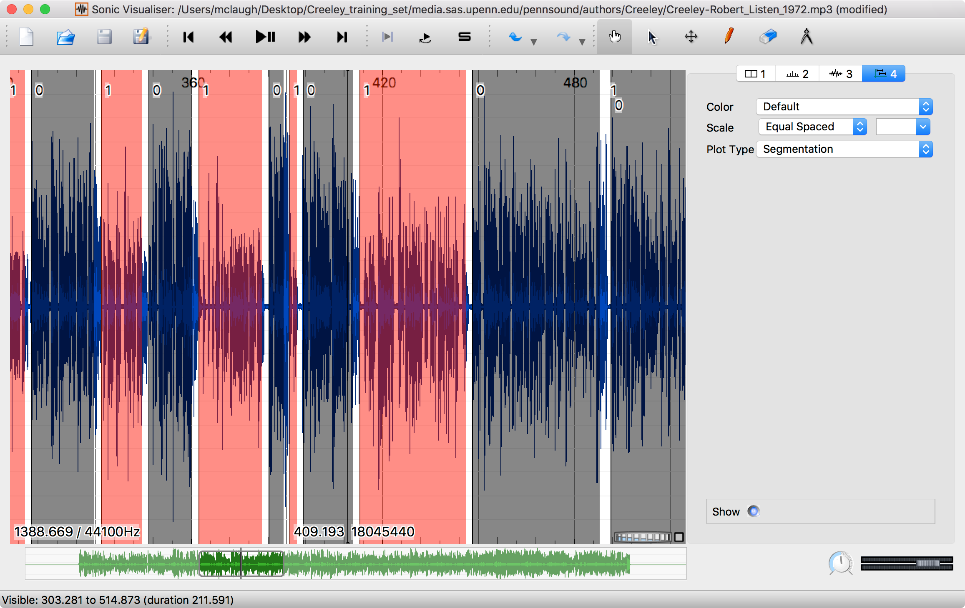
Stephen McLaughlin / @SteveMcLaugh

Slide 57
142.000000000,0,4.000000000,Applause
498.000000000,0,10.000000000,Applause
512.024761904,1,1406.000000000,Robert Creeley
1937.000000000,0,23.000000000,Applause
Sonic Visualiser
CSV file
Stephen McLaughlin / @SteveMcLaugh
Notes:
In the grand scheme, this is really refreshing. This is the whole session file — it has a hardcoded reference to the file’s pathname, totally transparent. But I take issue with the “frame” field ...
The sample rate is there, so one could check the timing later — but my real aim is to make this stuff friendly for humanists, who tend to be bad programmers — like me, by the way. I’m a bad programmer. I’m trying, but ... I’ll never be on the level of someone like Tony.
A lot of core GNU utilities have a –h option for human readability.
Be the -h you want to see in the world
PyDub handles this commendably: uses milliseconds regardless of sample rate

Slide 58
Stephen McLaughlin / @SteveMcLaugh
Notes:
#metadatagoals

Slide 59
Stephen McLaughlin / @SteveMcLaugh
Notes:
#metadatagoals

Slide 60
Types of machine learning
Regression
output: a number
Classification
output: a class (i.e., category)
Stephen McLaughlin / @SteveMcLaugh
Notes:
#metadatagoals

Slide 61
Disciplines in audio ML
Music information retrieval (MIR)
audio fingerprinting (Shazam)
automatic transcription
audio thumbnailing
Speech to text
Speaker recognition
speaker identification
speaker verification
Stephen McLaughlin / @SteveMcLaugh
Notes:
#metadatagoals

Slide 62
Some key algorithms
Linear regression
numbers in, numbers out
Logistic regression
numbers and/or classes in, classes out
Stephen McLaughlin / @SteveMcLaugh
Notes:
#metadatagoals

Slide 63
Some key supervised learning algorithms
Linear regression
numbers in, numbers out
Logistic regression
numbers and/or classes in, classes out
Stephen McLaughlin / @SteveMcLaugh
Notes:
#metadatagoals

Slide 64
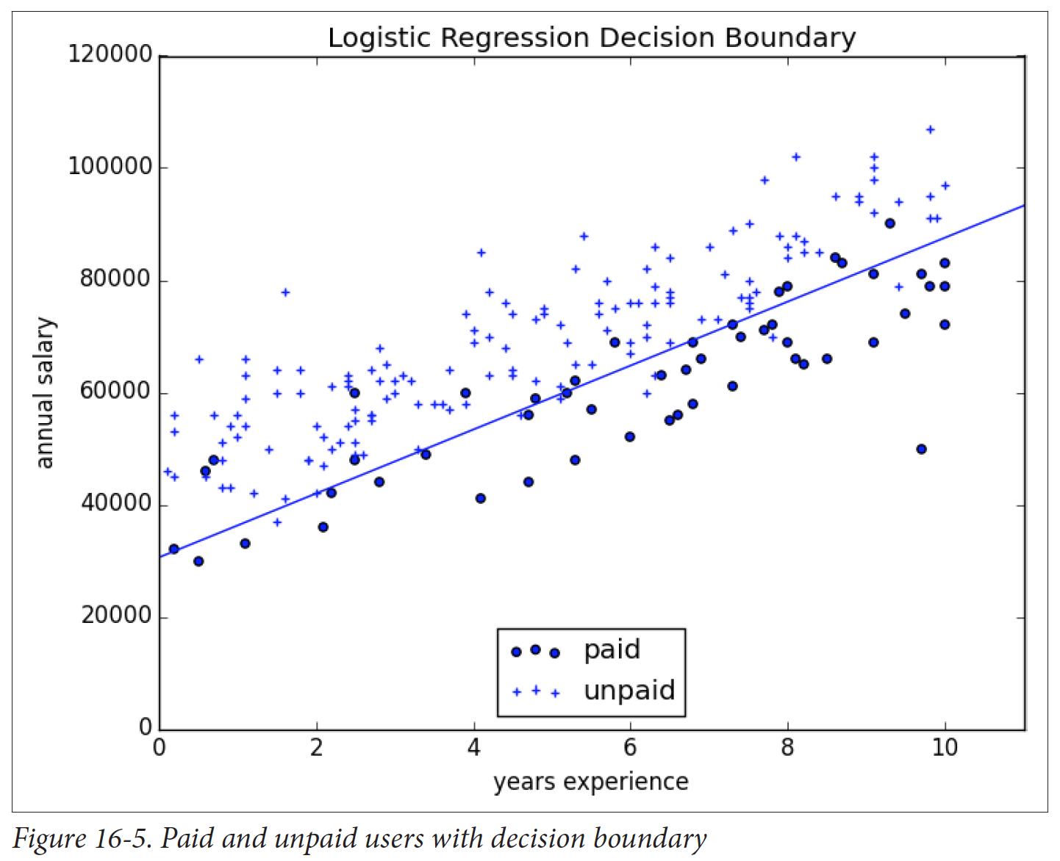
Logistic regression
prone to overfitting (training data not representative of real world)
Credit: Grus 2015
Stephen McLaughlin / @SteveMcLaugh
Notes:
Gradient boosting is a version of decision trees ... like they cut off the teee at some point?Both random forest and gradient boosting are optimization of decision trees

Slide 65
K nearest neighbor
the curse of dimensionality
intuitive, but not very efficient
Credit: Grus 2015
Stephen McLaughlin / @SteveMcLaugh
Notes:
#metadatagoals

Slide 66
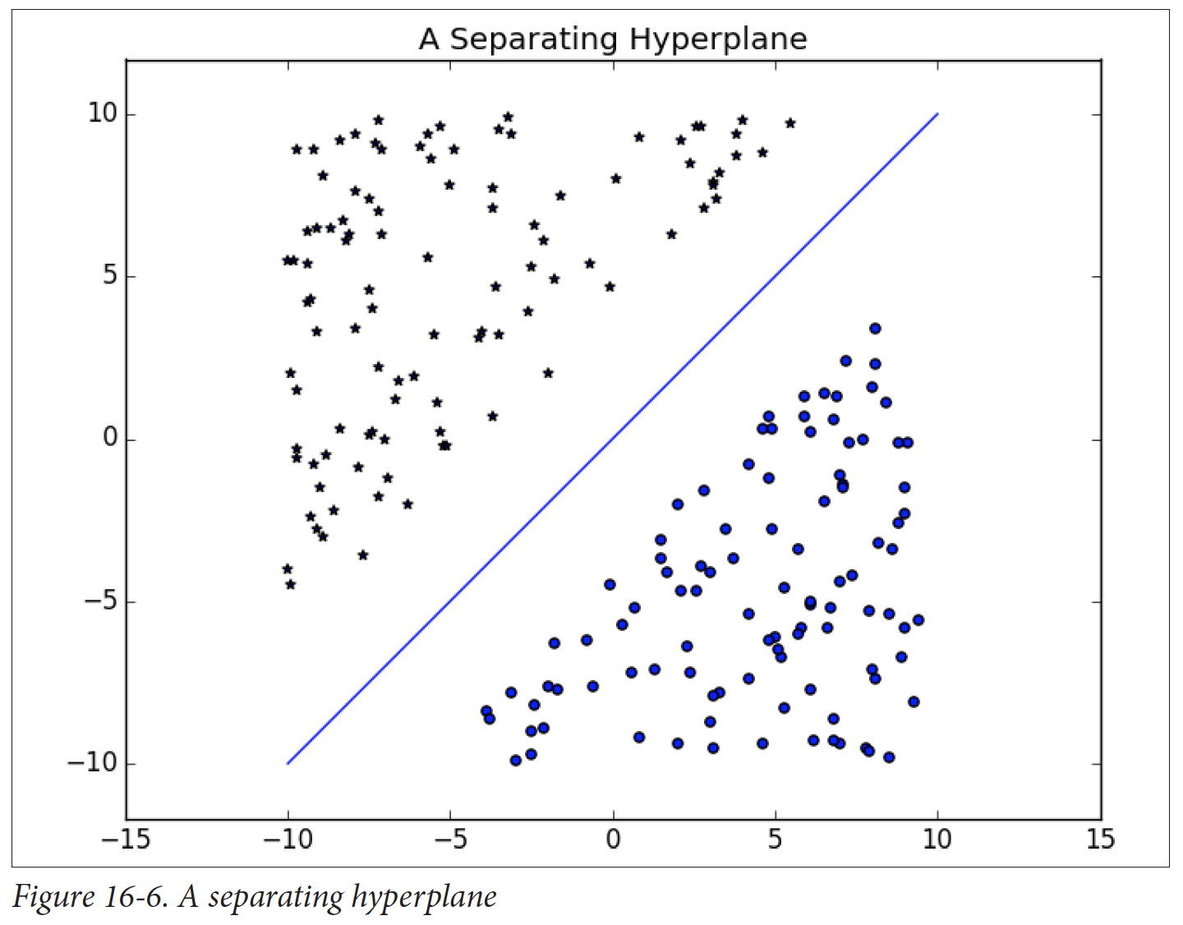
Support
vector
machine
(SVM)
Fast, cheap, and pretty good
Your #1 go-to
Credit: Grus 2015
Stephen McLaughlin / @SteveMcLaugh
Notes:
#metadatagoals

Slide 67
Decision
trees
Slower than SVMs
Highly interpretable results
Random forests and gradient boosting are improved variations
Credit: Grus 2015
Stephen McLaughlin / @SteveMcLaugh
Notes:
#metadatagoals

Slide 68
Gaussian
mixture
models
OK with shades of gray
Well-suited for speaker identification
Credit: Yu Zhu
Stephen McLaughlin / @SteveMcLaugh
Notes:
#metadatagoals

Slide 69
Neural networks
“The future”
Output not interpretable
Slow, expensive, steep learning curve
Credit: Wikimedia Commons
Stephen McLaughlin / @SteveMcLaugh
Notes:
#metadatagoals

Slide 70
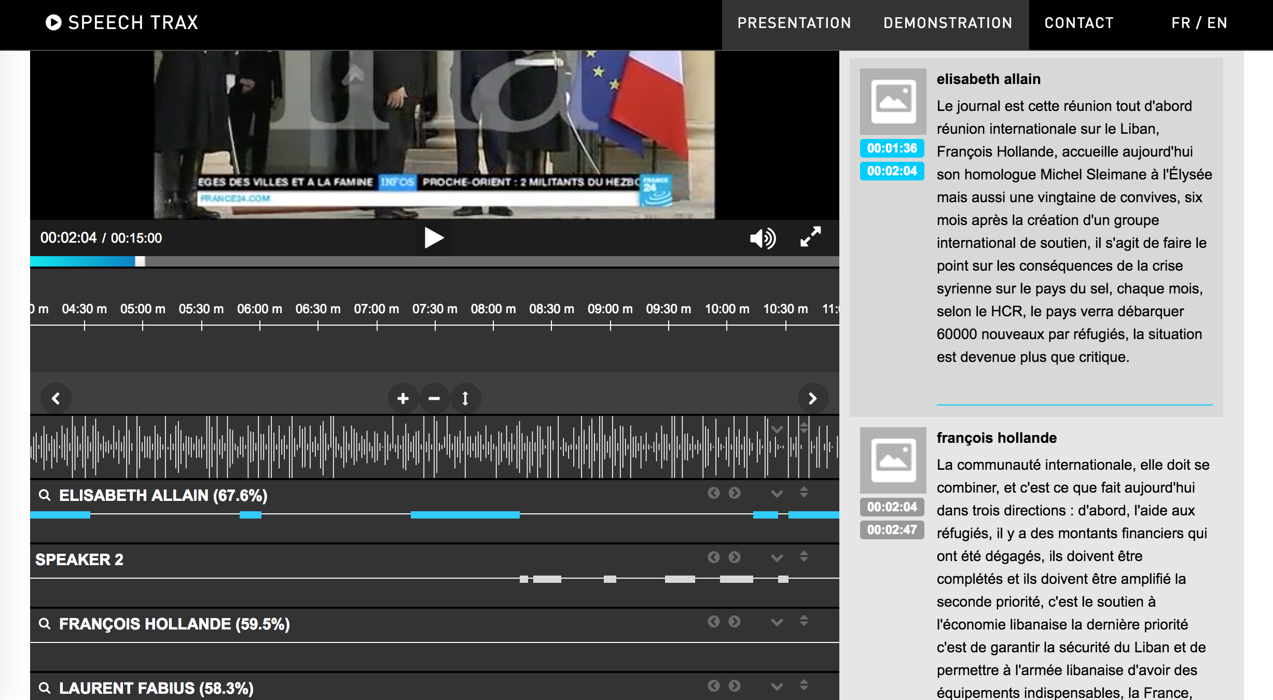
ML in archives
Stephen McLaughlin / @SteveMcLaugh

Slide 71
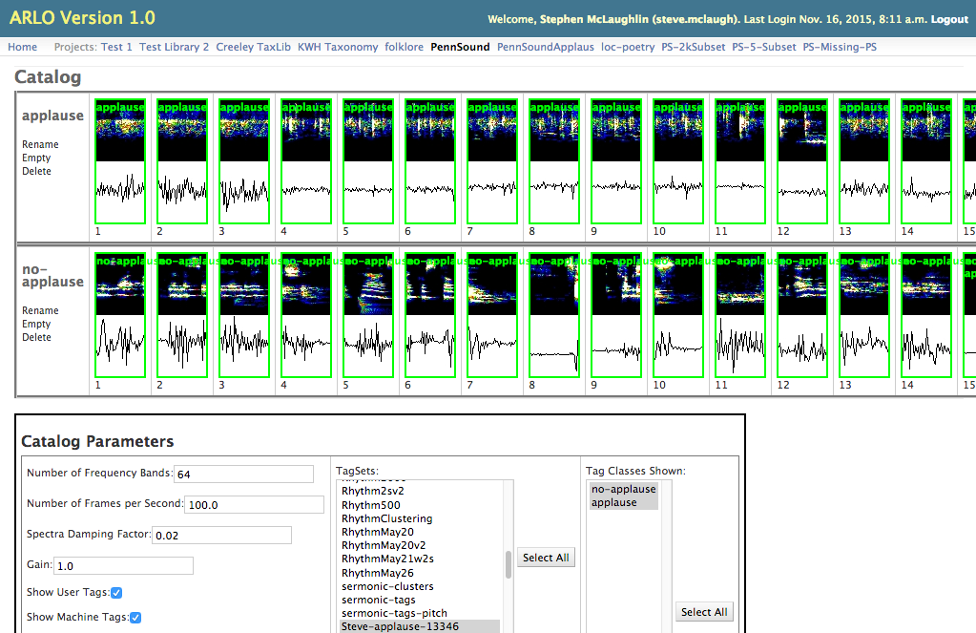
Stephen McLaughlin / @SteveMcLaugh
Notes:
Gradient boosting is a version of decision trees ... like they cut off the teee at some point?Both random forest and gradient boosting are optimization of decision trees

Slide 72
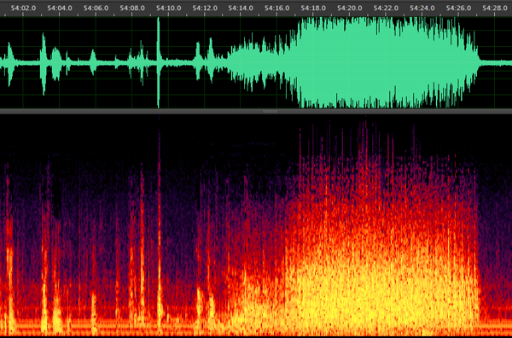
Reading by Charles Olson, Vancouver Poetry Conference, 1963
Stephen McLaughlin / @SteveMcLaugh

Slide 73
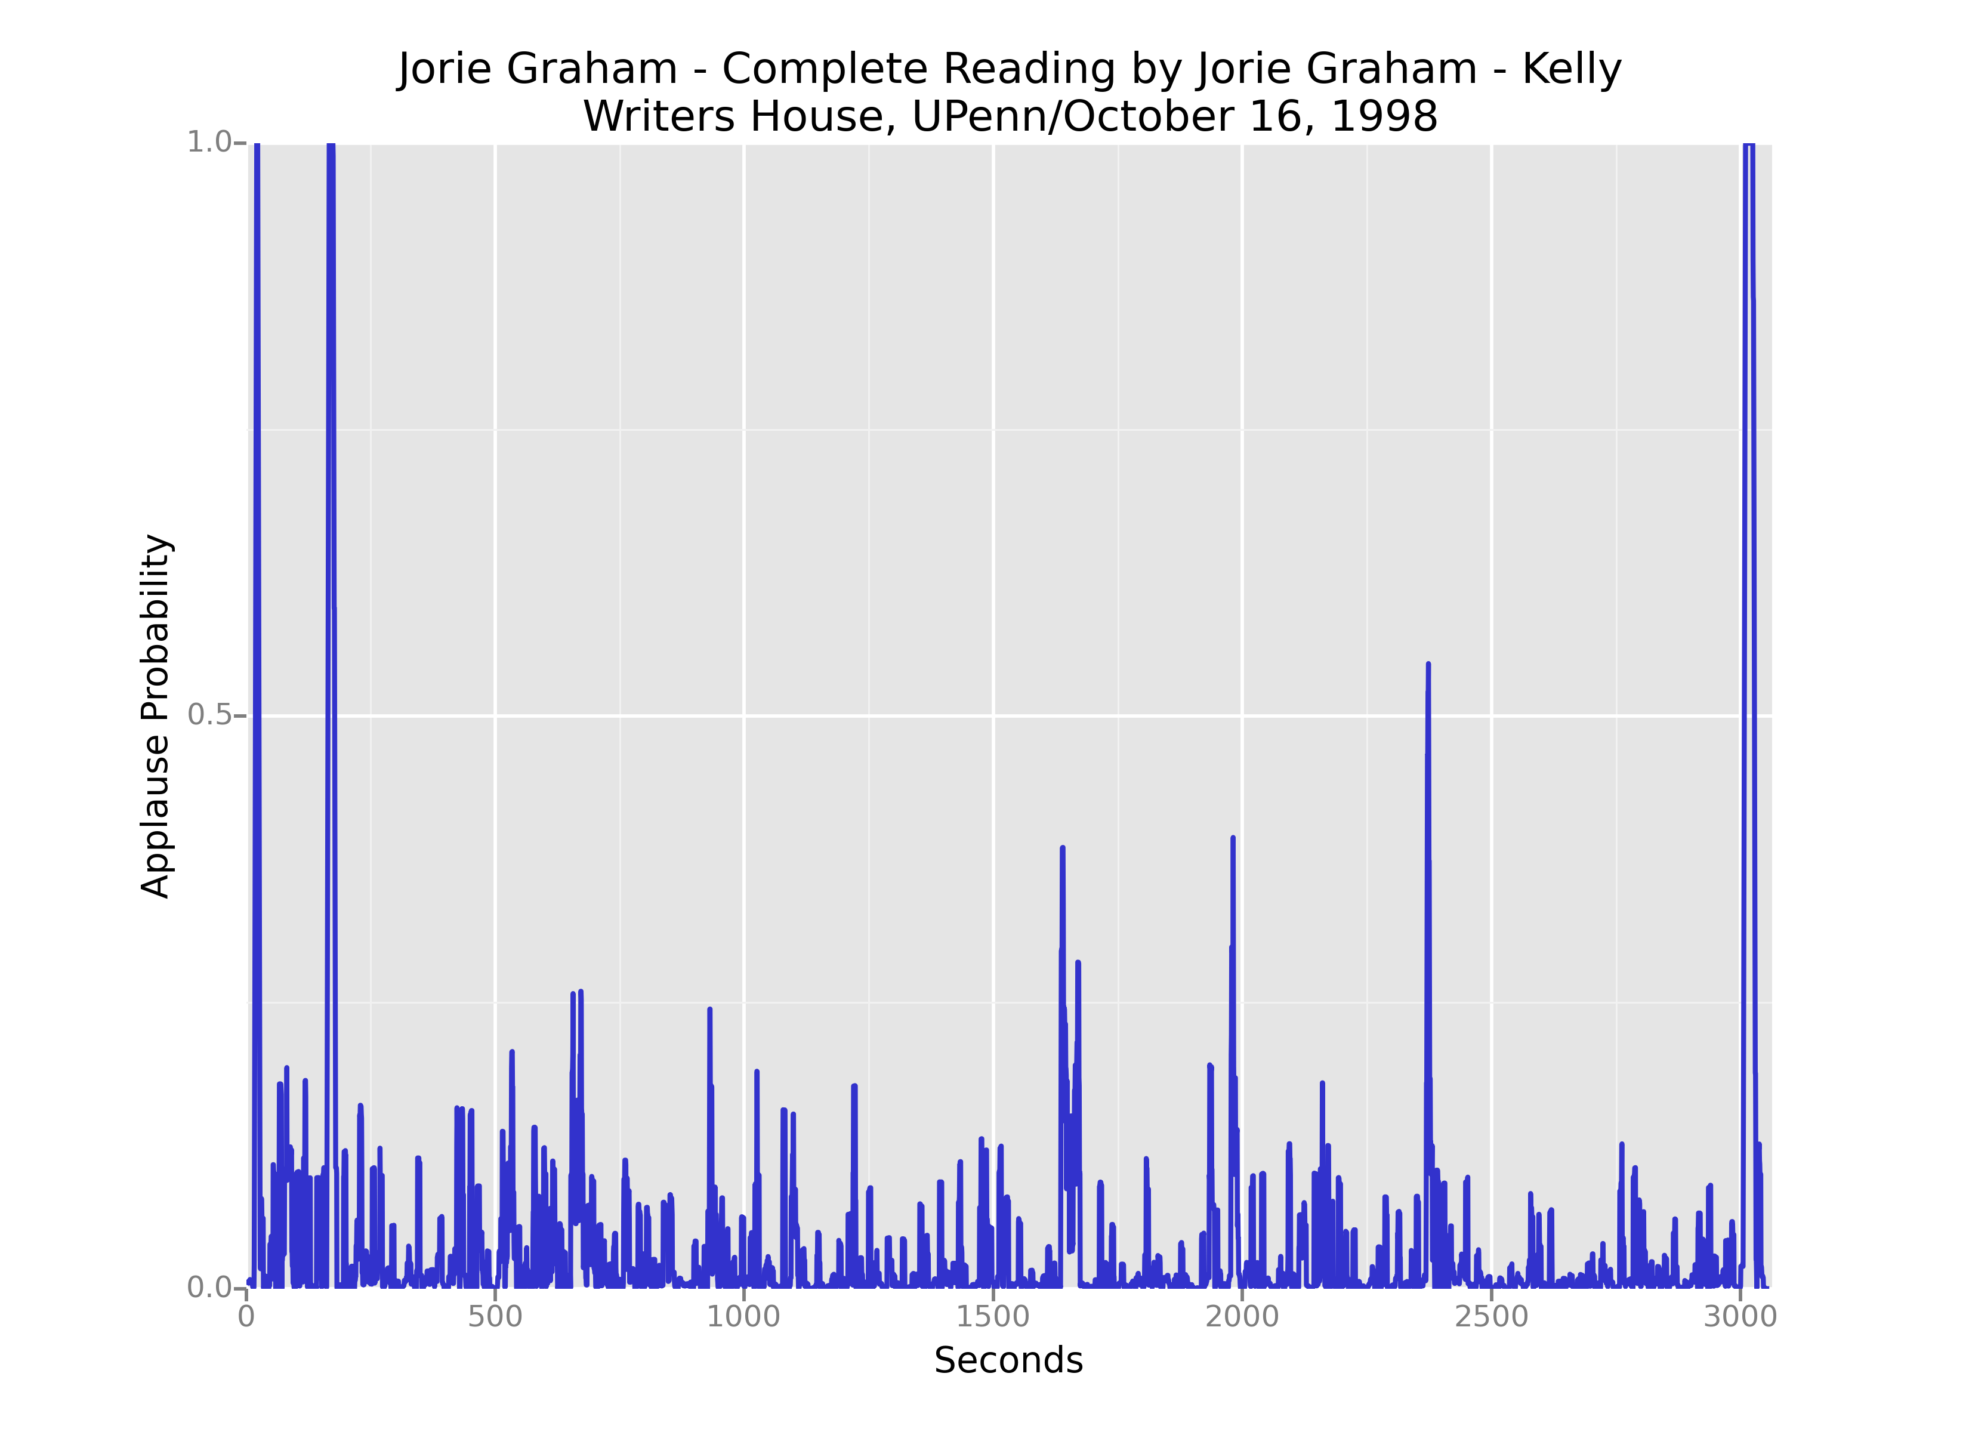
Stephen McLaughlin / @SteveMcLaugh
Notes:
SVM
"This is the idea behind the support vectormachine, which finds the hyperplane that maximizes the distance to the nearest pointin each class (Figure 16-6)."- data science from scratch

Slide 74
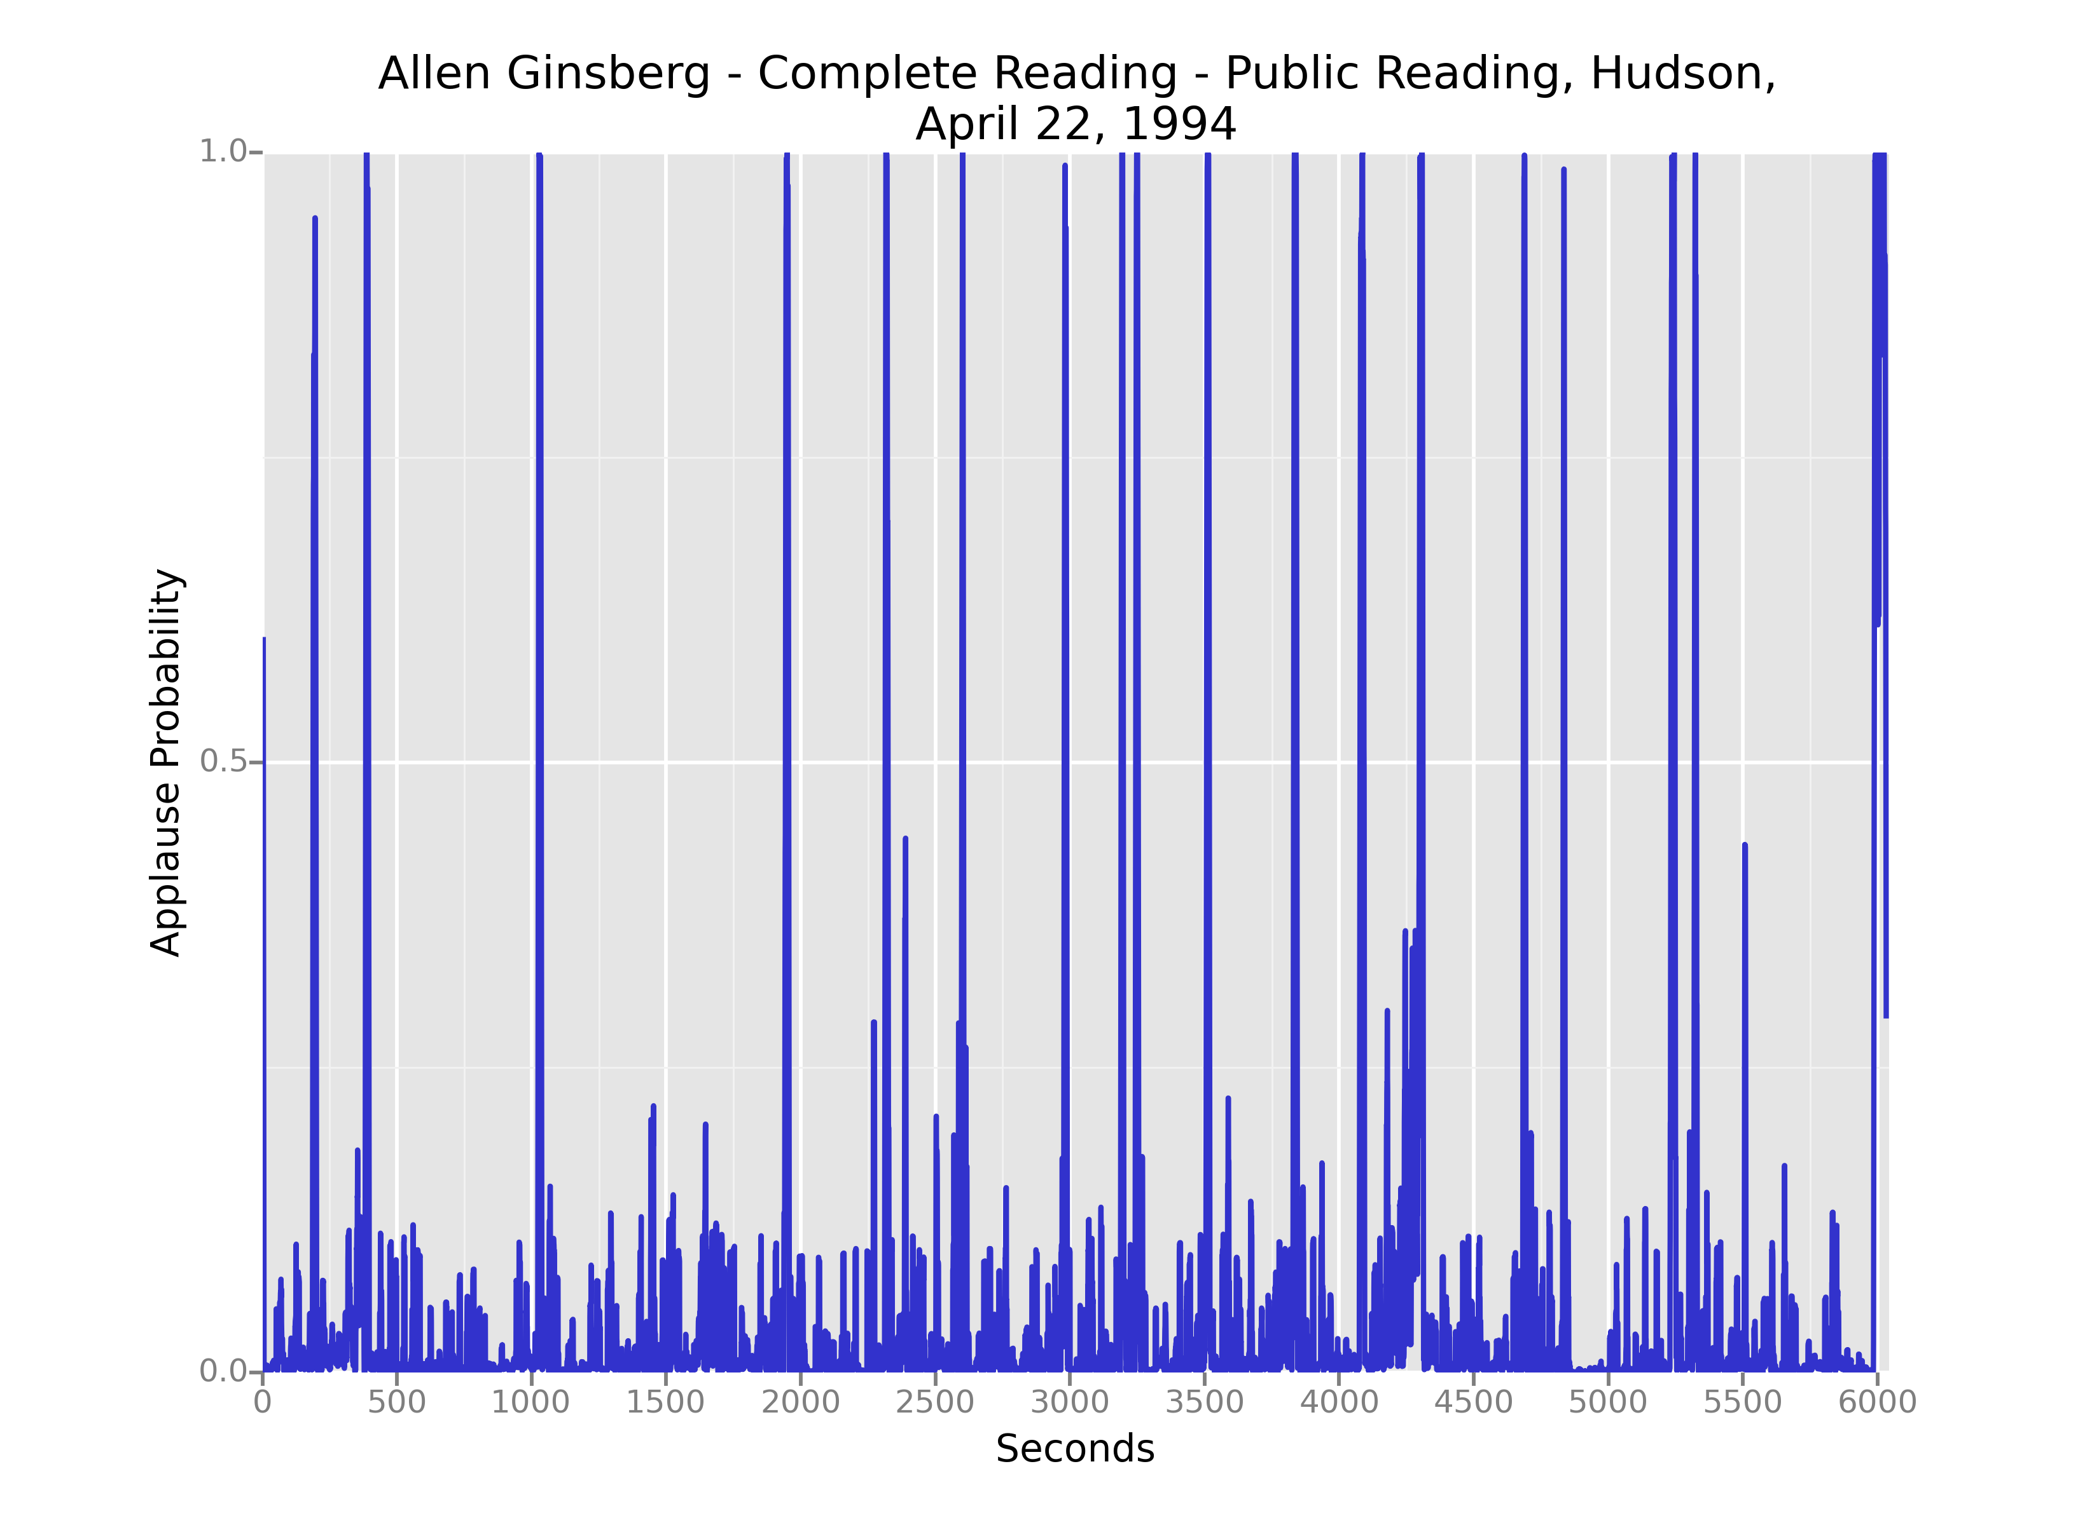
Stephen McLaughlin / @SteveMcLaugh
Notes:
Gradient boosting is a version of decision trees ... like they cut off the teee at some point?Both random forest and gradient boosting are optimization of decision trees

Slide 75
Stephen McLaughlin / @SteveMcLaugh
Notes:
SVM
"This is the idea behind the support vectormachine, which finds the hyperplane that maximizes the distance to the nearest pointin each class (Figure 16-6)."- data science from scratch

Slide 76
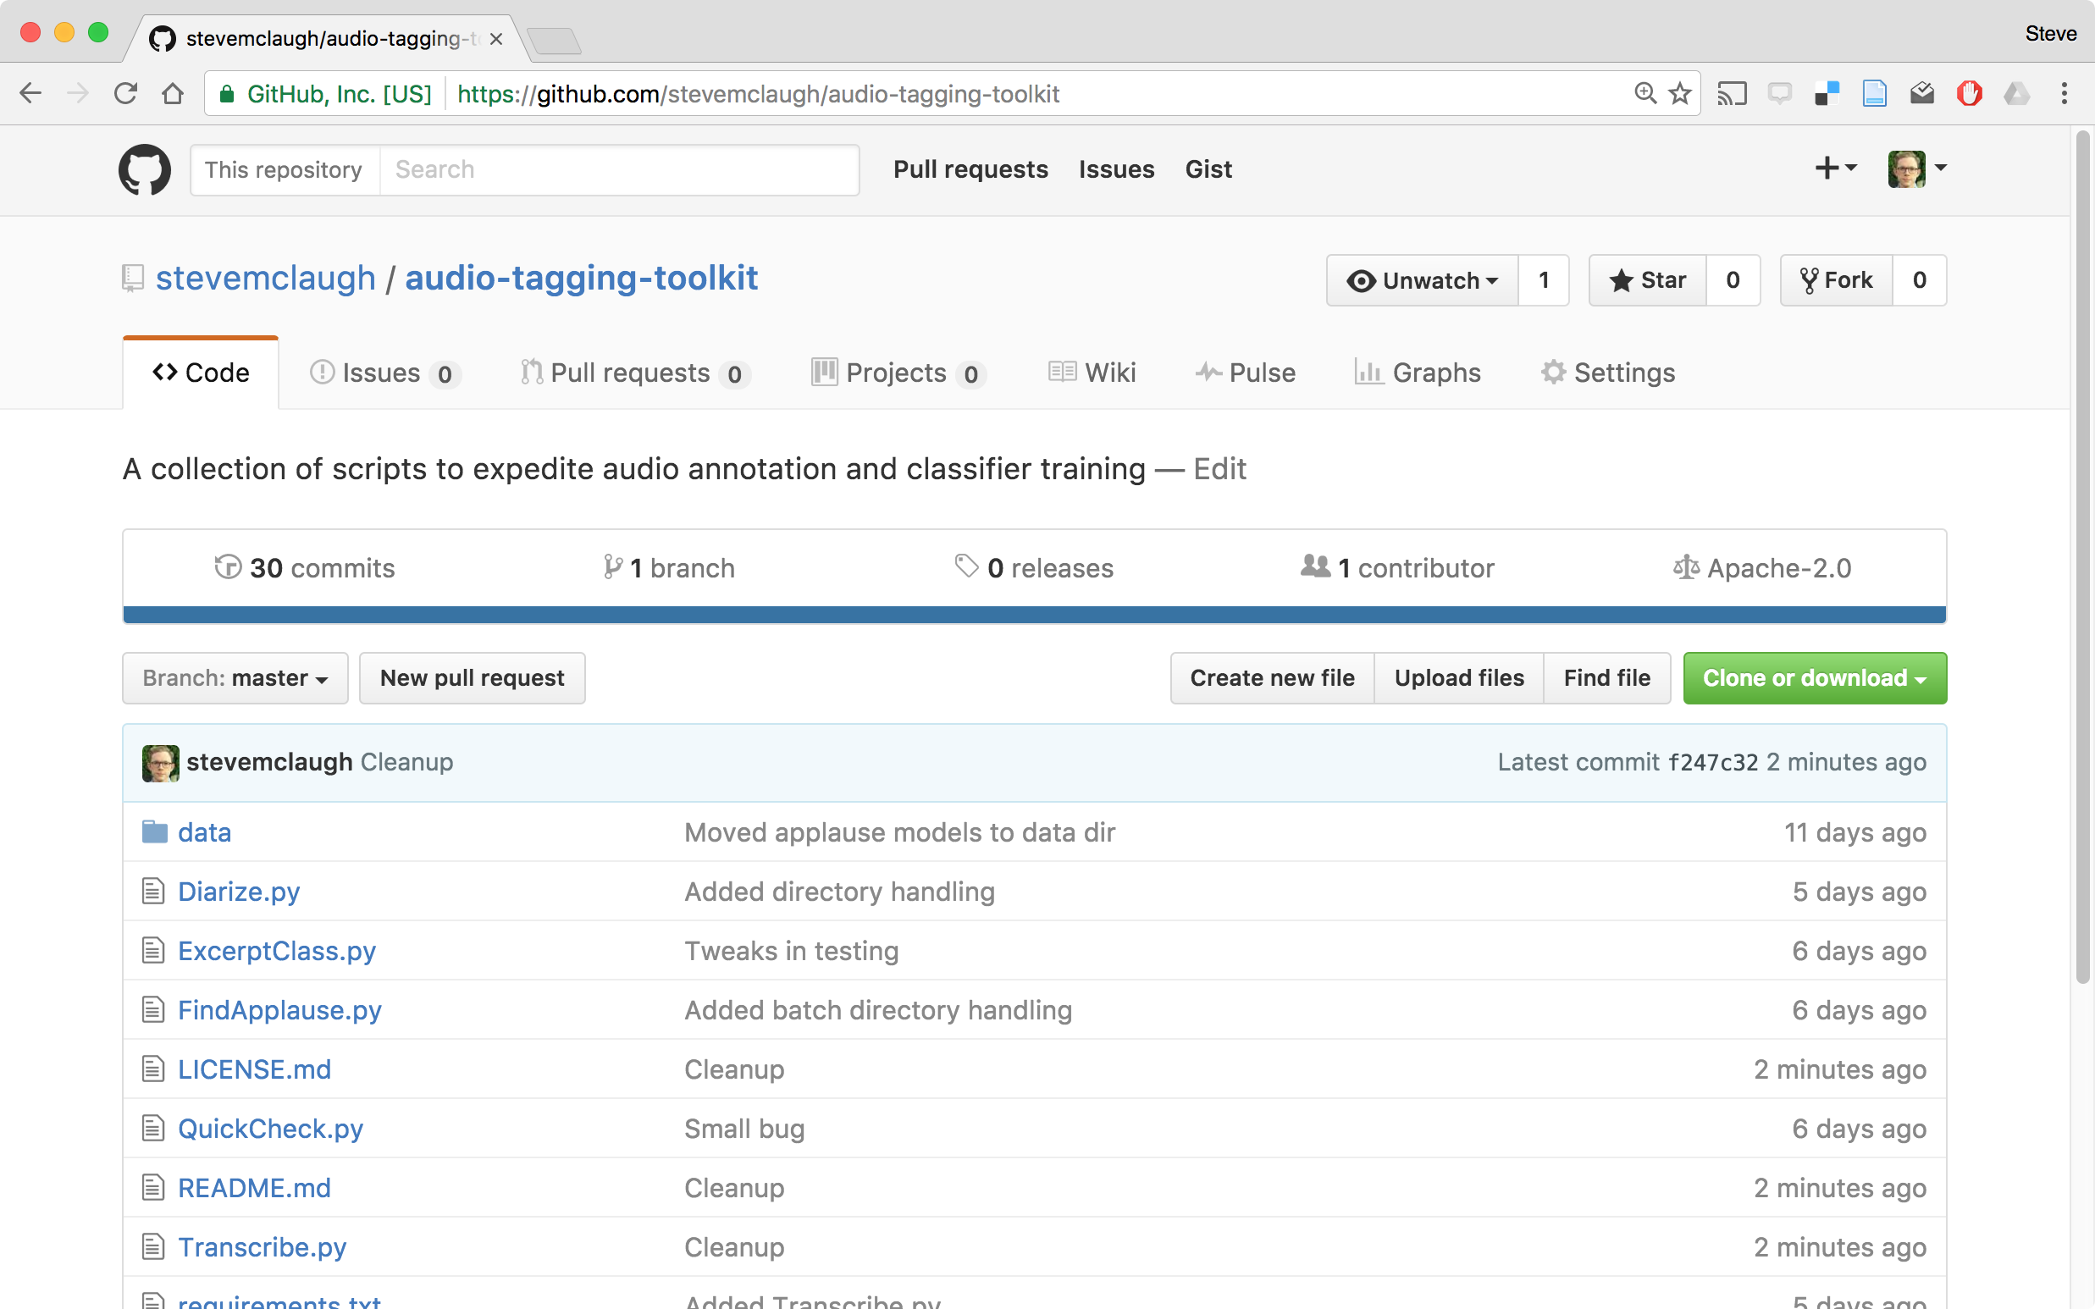
Stephen McLaughlin / @SteveMcLaugh
Notes:
REPLACE

Slide 77
Stephen McLaughlin / @SteveMcLaugh
Notes:
SVM
"This is the idea behind the support vectormachine, which finds the hyperplane that maximizes the distance to the nearest pointin each class (Figure 16-6)."- data science from scratch

Slide 78
Stephen McLaughlin / @SteveMcLaugh
Notes:
SVM
"This is the idea behind the support vectormachine, which finds the hyperplane that maximizes the distance to the nearest pointin each class (Figure 16-6)."- data science from scratch

Slide 79

⟶
applause detection and/or diarization
⟶
manual validation
⟶
speaker recognition
⟶
manual validation
⟶
annotated corpus
⟶
retrieval, segmentation, new ML training, etc.
Stephen McLaughlin / @SteveMcLaugh
Notes:
*
If I was bitter or disillusioned about poetry culture, it was perhaps because I hadn’t found my own community.
But eventually I did.
In the years following Issue 1 I got involved in practice.
I submitted videos to Ubuweb.
I did archival work for PennSound and edited the podcast PoemTalk at the Writers House.
I hosted my own poetry interview podcast on Jacket2.org
And I hosted a reading series in Philadelphia from 2011 to 2014, called Principal Hand Presents.
The scene I was a part of — conceptual, post-conceptual — was essentially a complete gift economy.
Giving chapbooks away, sharing PDFs, swapping ideas and links on email threads.
- That became central to my understanding of what it was to write, to make things. Not an alternative to mass culture, but a parallel track where we had some autonomy.

Slide 80
Stephen McLaughlin / @SteveMcLaugh
Notes:
This is not an option.

Slide 81
General metadata goals
Segmentation by speaker
Segmentation by event structure
High-level labels
Language
Genre
Topic/theme
Low-level labels
Notable passages
Material features/quirks
Stephen McLaughlin / @SteveMcLaugh
Notes:
#metadatagoals

Slide 82
General search goals
Acoustic fingerprint search (à la Shazam)
Locate speaker of interest
Locate sound classes of interest
Full-text search
Stephen McLaughlin / @SteveMcLaugh
Notes:
The means to creating useful metadata as in the previous slide

